Slide 1





CATMEMES
OVERHAMRADIO
Slow Scan TV – ZiaCon 2024

Slide 2



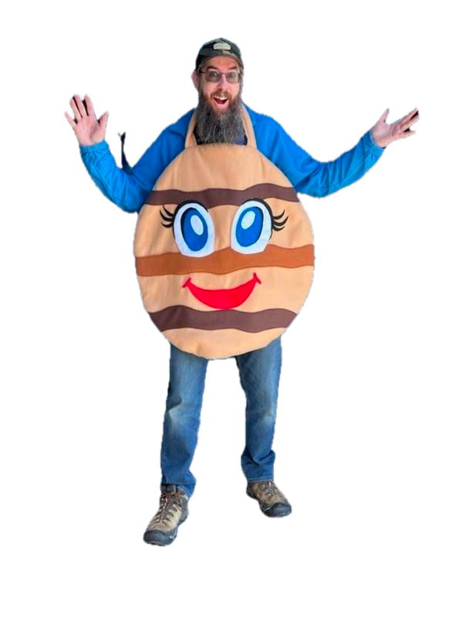



INTRO
I’m hamster
KD5WGW
electronics and ham radio nerd
yes I’m glad cookie season is over

Slide 3

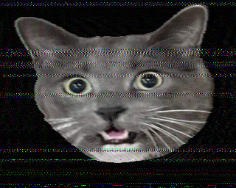
WHAT IS SSTV
Slow Scan TV is a collection of various encoding methods used to convert an image into a sound that can be transmitted and reconstructed at a distance
A single 320x256 image takes about 110 seconds to transmit, so this is not ‘live’ TV (aka Fast Scan TV) – just images

Slide 4

SSTV HISTORY
1957
COPTHORNE MACDONALD
Invented the first algorithm
1960s
SPACE IMAGES
USSR and NASA used forms of SSTV to beam back images
1968
LEGALIZED FOR HAMS
FCC allows ‘advanced’ class amateurs to broadcast SSTV
1990s
SOFTWARE DEVELOPED
Home PCs began to get software to encode/decode

Slide 5
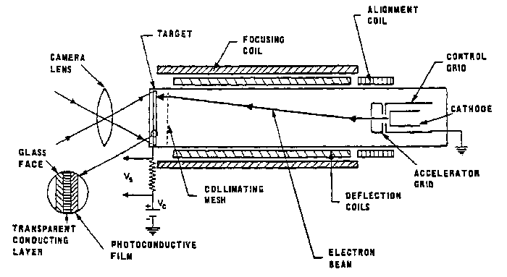
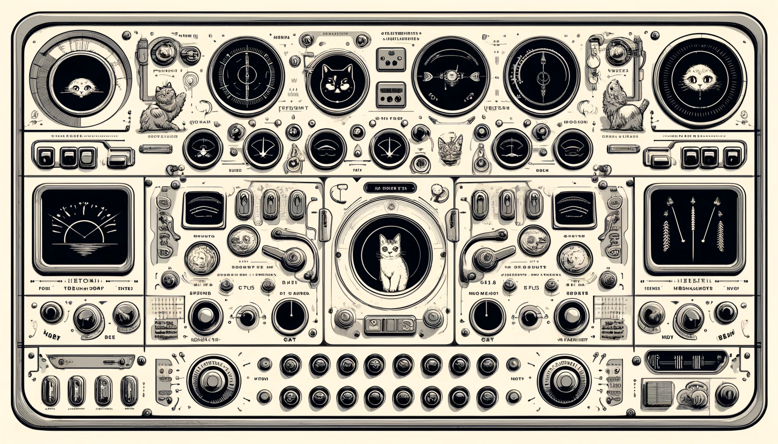
EARLY SSTV
Specialized hardware called a Vidicon tube was required to encode an image
Original was 120 lines, 120 pixels per line

Slide 6
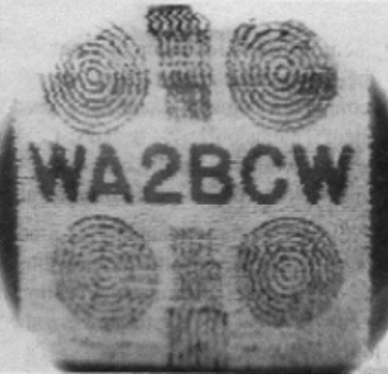
Total bandwidth for SSTV images is around 3khz – as opposed to 3Mhz for black and white television or 6Mhz for color television
Originally, images displayed on CRT screens and faded out slowly. Size and transmission time were selected to allow for a whole image to be persistent for about 8 seconds.
The first trans-Atlantic image

Slide 7





PERSISTANCE OF VISION
DIGITAL STORAGE
Early SSTV needed special hardware, and took advantage of the properties of CRT screens to display images
As PCs became available, images could be decoded and saved via digital means

Slide 8
MODERN SSTV
Many free software packages exist to encode and decode SSTV
You can even encode and decode on your phone
IMAGE HERE

Slide 9

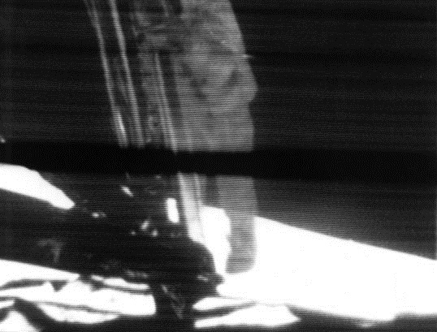

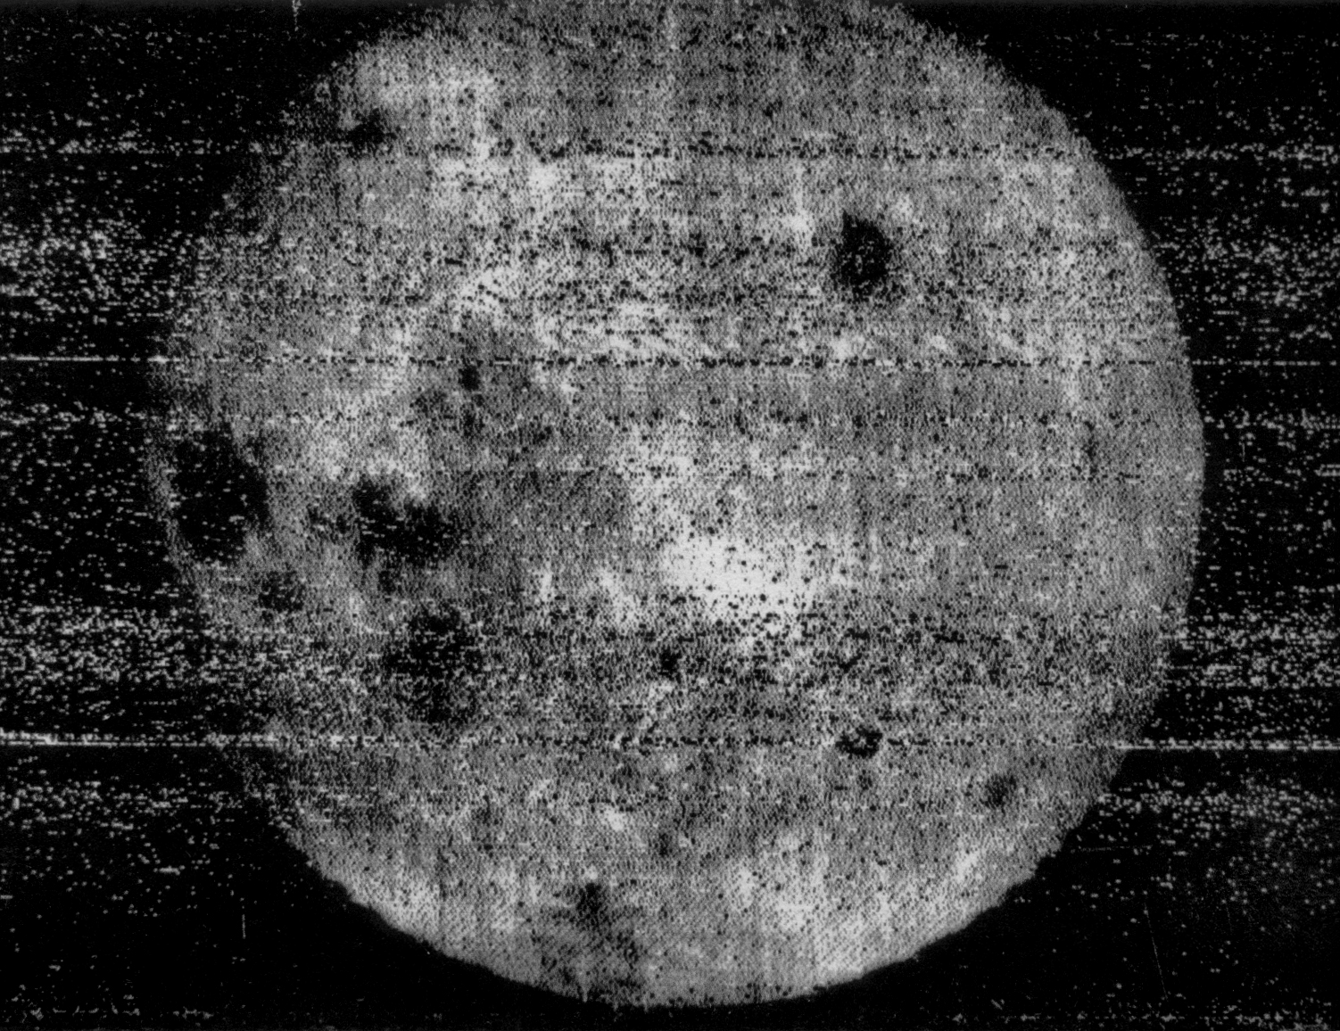

THE TIMELINE
1959
EARLY 1980s
Russian Luna 3 first images of the far side of the moon
Robot Research Corp develops commercial units
FIRST IMAGES
SPACE
APOLLO
COMMERCIAL
1958
1960s
Work was improved by hams over a 10 year period
NASA makes use of SSTV in space missions

Slide 10
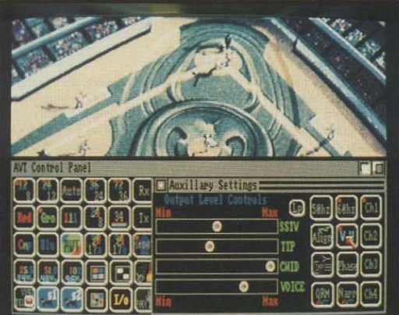
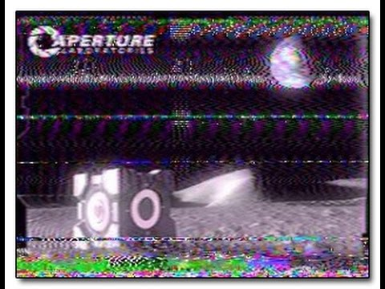
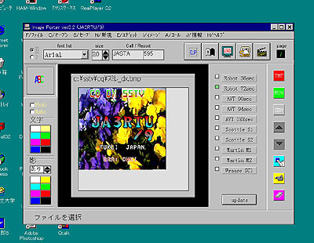
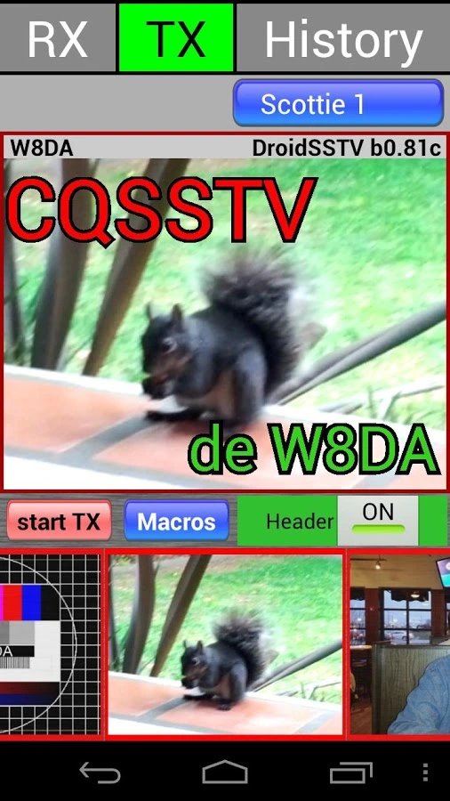
THE TIMELINE
1990s
2010s
Improved sound cards allow for software decoding
Phone applications become available for SSTV on the go
AMIGA
IBM PC
POP CULTURE
PHONE
1990
2007
Interface developed for Amiga computers - AVT
Valve uses hidden SSTV audio in game

Slide 11


FANTASY IS THE GATEWAY TO THE IMPOSSIBLE, THE LAND WHERE THE ORDINARY BECOMES EXTRAORDINARY, AND THE IMPOSSIBLE BECOMES POSSIBLE. IT IS THE REALM OF THE IMAGINATION, WHERE ANYTHING CAN HAPPEN AND EVERYTHING IS POSSIBLE.
THE DREAM WEAVER

Slide 12
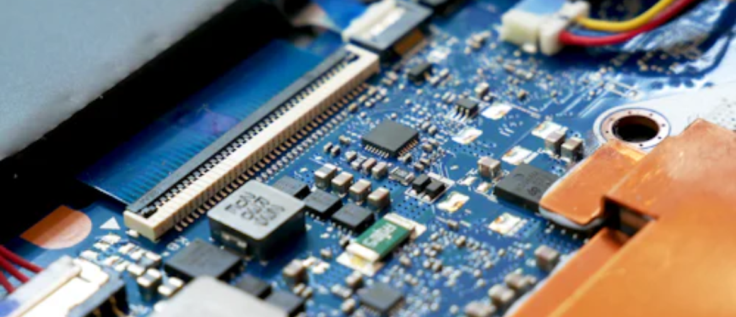
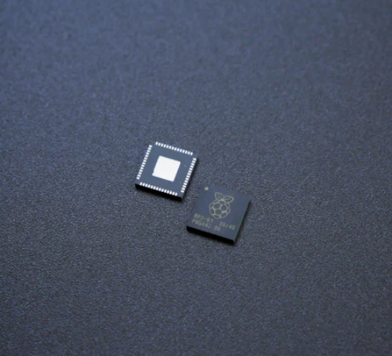
DRAGON
UNICORN
DRAGON
A guide to taming and caring for dragons in the realm of magic.
Tips and tricks for spotting the elusive unicorns in their natural habitat.
A guide to taming and caring for dragons in the realm of magic.

Slide 13



THE MAGIC OF DRAGONS: A RESEARCH
"The Art of Archery": Discover the intricacies of the Art of Archery .
6.7M
4.4M
"The Music of the Elves": Immerse yourself in the enchanting music of the elves.
2.3M
"The Life of an Elf": Learn about the customs and daily life of the elves.

Slide 14



PRICING PLAN
BASIC
ELITE
LEGENDARY
Access to the entry-level dungeons.
A limited number of quests and battles.
Ability to form a small party.
Access to the intermediate dungeons.
A greater number of quests and battles
Ability to form larger parties with adventurers.
Access to the most challenging dungeons.
Unlimited quests and battles per month.
The ability to form the largest parties.
$10/MONTH
$50/MONTH
$100/MONTH

Slide 15






S
W
O
T
ECLIPSE
ECLIPSE
ECLIPSE
ECLIPSE
Rare event causes unpredictable magic.
Rare event causes unpredictable magic.
Rare event causes unpredictable magic.
Rare event causes unpredictable magic.
QUEST
QUEST
QUEST
QUEST
Adventurers seek immortal artifact.
Adventurers seek immortal artifact.
Adventurers seek immortal artifact.
Adventurers seek immortal artifact.

Slide 16

SOME DATA
70%
ENCHANTED CREATURES
possess the ability to cast spells.
60%
MAGIC-WIELDING INDIVIDUALS
practice the art of illusions.
90%
SPELLS CAST
are dark magic, foretelling danger.

Slide 17
234,567
Unicorn Sightings
A tally of the number of unicorns spotted in the fantasy realm.

Slide 18
233 COINS
85%
Treasure Found
Wished Granted
456 HOURS
674 KM
Duration of Spell Casting
Journey Distance

Slide 19





SOME GRAPH
100
90
80
70
60
50
34.574
40
Total
30
20
10
0
1
2
3
4
5
6
7
8
SPELLCASTING PROGRESS
TREASURE FOUND
A record of the amount of treasure found per month
A record of the number of spells cast per year

Slide 20

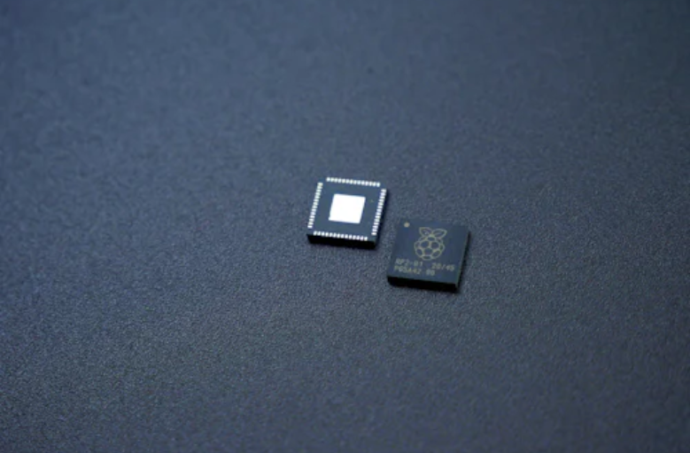
PORTAL TO ADVENTURE
A WEB APPLICATION
A web application designed for discovering the world of fantasy

Slide 21


THE FUTURE
AN MOBILE APP
An app designed for exploring and experiencing the enchanting realm of fantasy
Explore a magical world
Experience fantasy firsthand
Immerse in a realm of magic
Discover untold wonders
Live your fantasy dreams

Slide 22
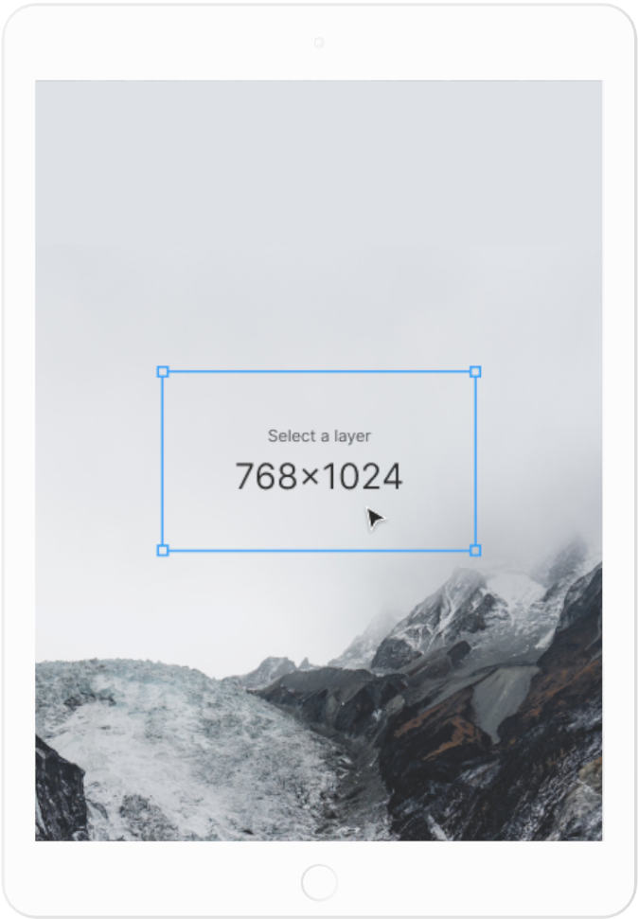
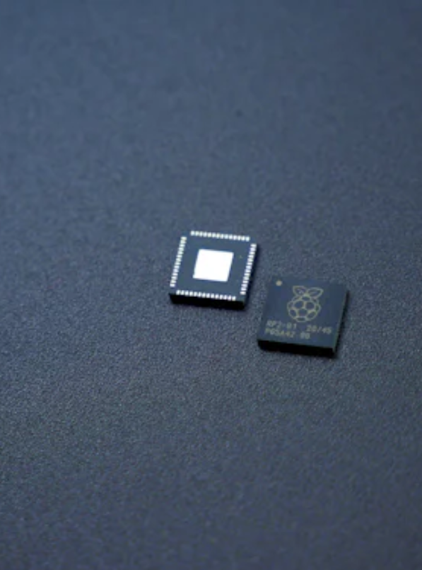
A GATEWAY TO
A WORLD OF
FANTASY AND
WONDER
Immerse yourself in the world of magic and mystery
Explore uncharted territories and fantastical lands
Meet mythical creatures and legendary beings
Uncover hidden treasures and secret treasures
A WEB APPLICATION
A web application designed for discovering the world of fantasy

Slide 23
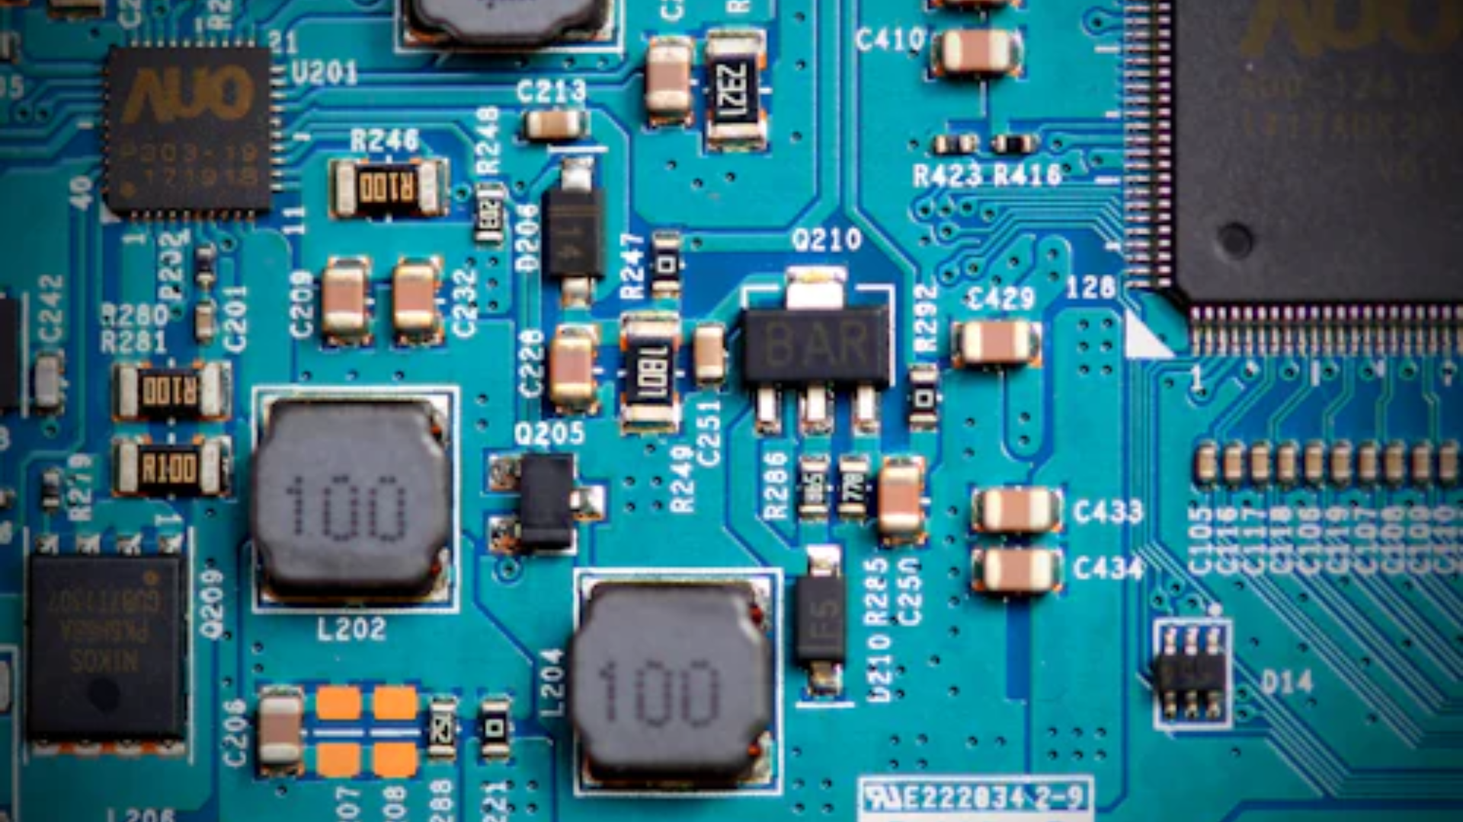
A MAGIC PICTURE

Slide 24

FANTASY REALM AT A GLANCE
THE FOREST
A magical forest filled with animals and enchanted creatures.
THE CAVES
A network of underground caves filled with gems and crystals.
THE LAIR
A dangerous and mysterious place where dragons reside.

Slide 25




THE TIMELINE
MAY
JULY
Shimmering City, conquest, Unicorn Crystal
Kingdom invaded, betrayal, hero's festival
ECLIPSE
QUEST
FOUNDATION
TRANSFORM
APRIL
JUNE
Eclipse, quest for artifact, volcano disaster
War, curse from artifact, magic discovery

Slide 26
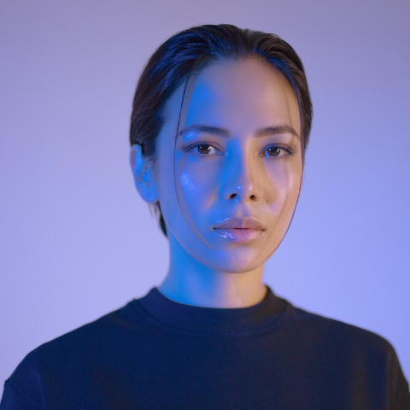


OUR TEAM
ELDRUIN
ELEMENTALEN
LUNARIA
The Fire Mage
The Guardian
The Moon Priestess

Slide 27









THE ORGANIZATION
CHLOE NG
The Mage
VALTORIN
AURIELLE
THERONIS
DARIANA
The Assassin
The Priestess
The Warrior
The Shaman
LUCIAN
ELVINA
The Conjurer
The Oracle
CEDRIC
SERAPHINA
The Timekeeper
The Lightbringer
To download more editable chart, click here

Slide 28

THANK YOU FOR
CHOOSING EATEMP
We offer free and high-quality slides templates for your presentations. We appreciate you choosing us and hope our templates have been helpful.
As a new website, we rely on your support to grow, so please help us by sharing our site with your friends and colleagues.
Credit | Image: Unsplash

